Slide 1


THINGSBOARD#GRAPH_MODELING
STUDENT
Rut bastoni
Prof.
Massimo Callisto De Donato

Slide 2
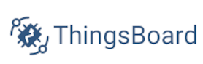
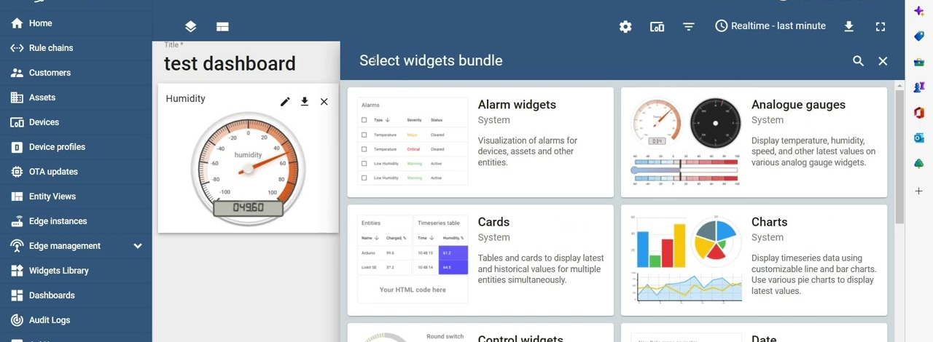
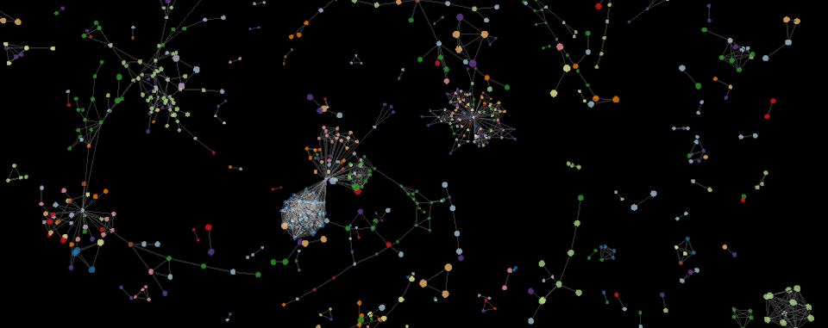
OBJECTIVE
The project aims to leverage the Thingsboard platform features to model the structure of buildings and premises of an organization, and the arrangement of IoT devices within it.
The Thingsboard platform is equipped with configurable dashboards and widgets, capable of showing complex analyses and visualizations. However, a graph-structure visualization widget is missing.
The objective is the development of a custom graphical widget for visualizing and managing the organization structure as a graph, as well as providing controls to handle relationships among devices and facilities, and also showing devices telemetry.

Slide 3
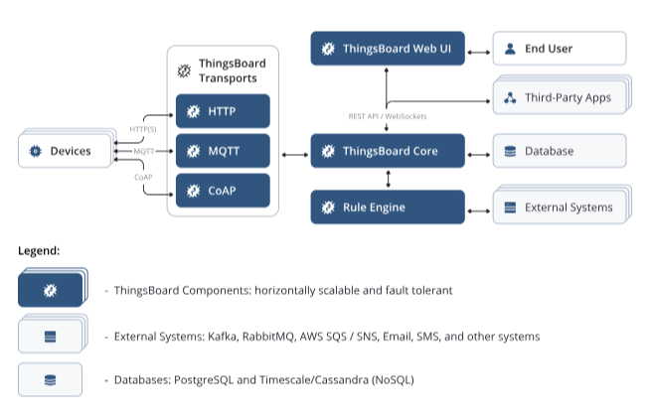
THINGSBOARD ARCHITECTURE
ThingsBoard is an open-source IoT platform for data collection, processing, visualization, and device management.
It enables device connectivity via industry standard IoT protocols - MQTT, CoAP and HTTP and supports both cloud and on-premises deployments. ThingsBoard combines scalability, fault-tolerance and performance so you will never lose your data.
It is very adaptable to the business need letting the user choose setup between monolithic and microservice architecture.
For demonstration purposes a convenient docker configuration for a monolithic architecture installation has been prepared

Slide 4
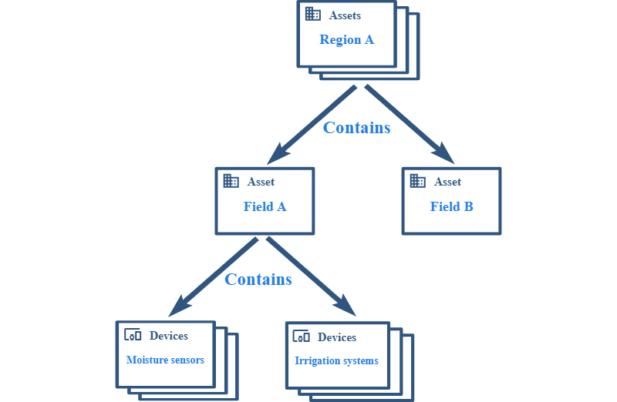
Entities modeling architecture
Locations, buildings, floors and rooms modeled as assets objects
IOT devices represented as device entities, and can collect telemetry data
Relations among objects represent ownership and management relationships among physical locations and devices

Slide 5
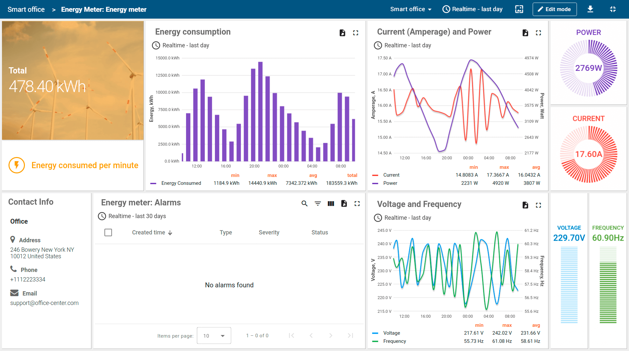
IOT DASHBOARDS
Data Visualization: Users can create various widgets such as charts, graphs, tables, and more to visualize data obtained from connected devices.
Device Management: Dashboards can be used to perform management operations on devices.
Interactivity: Dashboards can be designed with interactive elements such as buttons, switches, etc.
Display Customization: Users can customize visualization aspects to create a user-friendly and informative interface.
Role-Based Access: Access to dashboards controlled with different levels of privileges based on user roles.
Extensibility with widgets: Possibility to enrich the set of provided system widget with custom developed additional UI modules that seamlessly integrate into any IoT Dashboard.

Slide 6
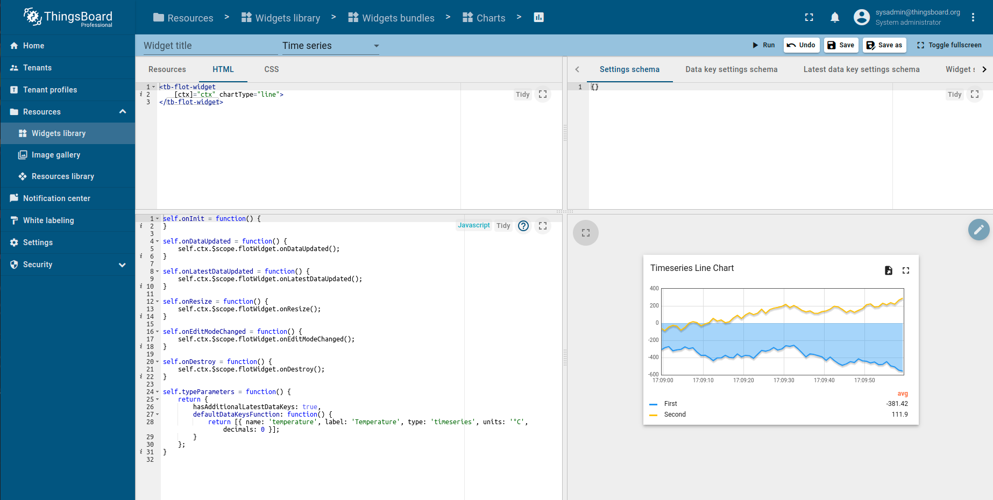
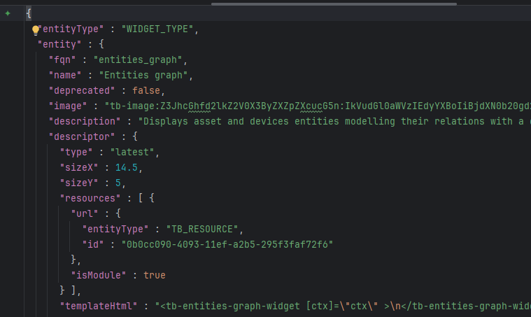
CUSTOM WIDGET DEVELOPMENT
Widget tailoring is made straightforward thanks to the platform-integrated mini IDE designed to develop custom widget definitions
It consists of top toolbar and four main sections:
Resources/HTML/CSS (external URLs also)
JavaScript
Settings schema
Widget preview
Final result is encapsulated in JSON-entity format, utilized to store every kind of object in platform (entities, dashboards, devices, etc).

Slide 7
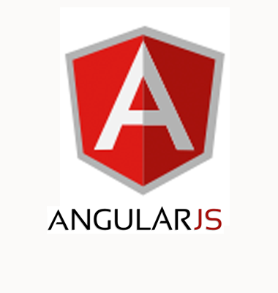
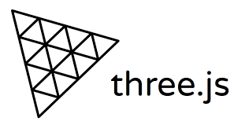
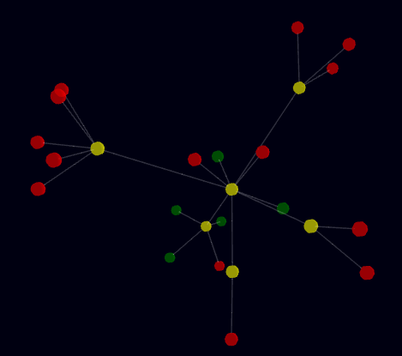
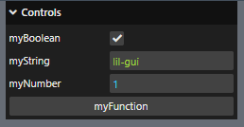
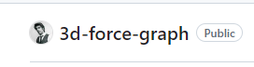
INTEGRATING EXTERNAL LIBRARIES INTO WIDGET DEFINITION
JavaScript libraries or existing code can be reused/integrated to create new widgets, by means of Resources that are modelled like other entities in the Thingsboard platform
https://thingsboard.io/docs/user-guide/contribution/widgets-development/

Slide 8
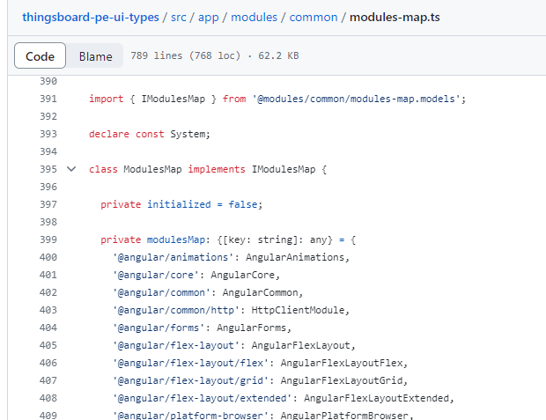
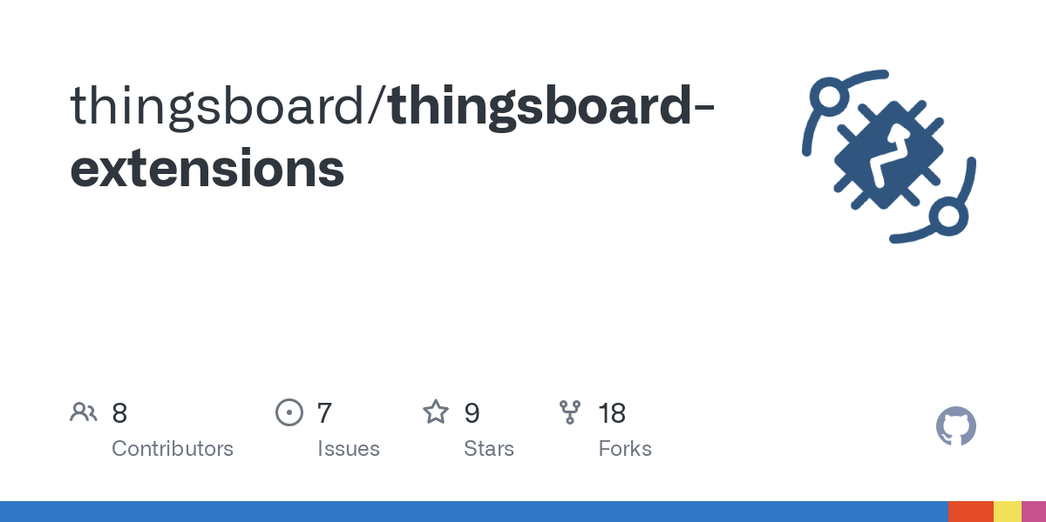
THINGSBOARD EXTENSIONS
ThingsBoard extensions is an additional project, mantained by Thingsboard community, that lets you create your own Angular components and use them in your widgets and actions.
It allows to reuse code, providing all functionality of TypeScript, RXJS, Angular, exports of standard UI Thingsboard components, etc.
It has been forked and used in the project as a starting point to develop the custom Graph Widget, leveraging the ready-to-use standard components, like entities datasources, telemetry table, and REST APIs wrappers.
https://github.com/thingsboard/thingsboard-extensions

Slide 9
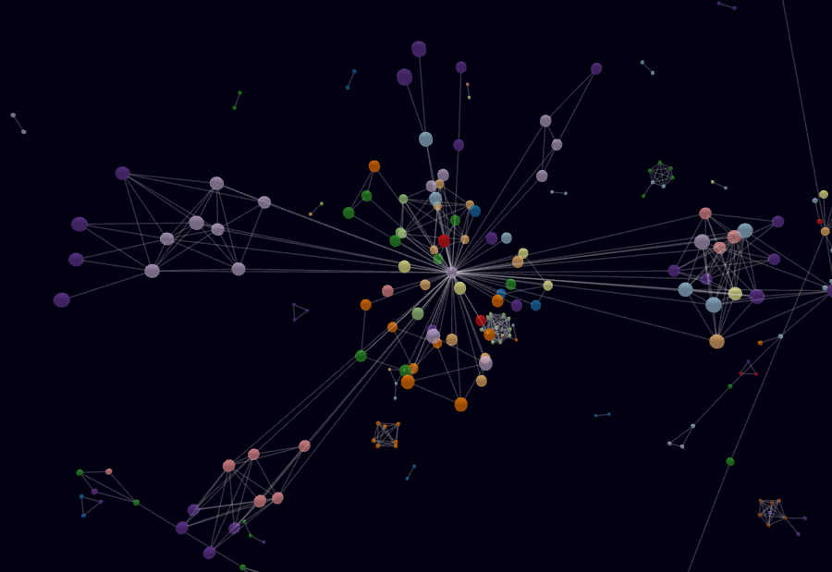
3D Force-Directed Graph LIBRARY
Force-directed graph drawing algorithms are a class of algorithms for drawing graphs in an aesthetically-pleasing way.
https://en.wikipedia.org/wiki/Force-directed_graph_drawing
3D Force-Directed Graph is the most popular web component for representing a graph data structure in a 3-dimensional space using a force-directed iterative layout.
It has been imported into the forked extension codebase as a YARN dependency and used to render the assets and devices hierarchy as a graph structure.
https://github.com/vasturiano/3d-force-graph

Slide 10
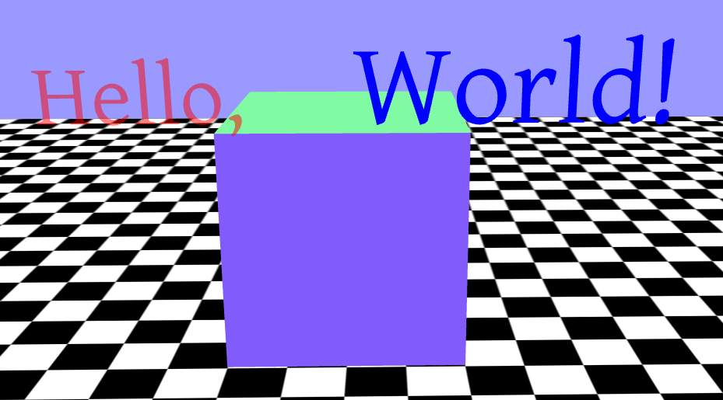
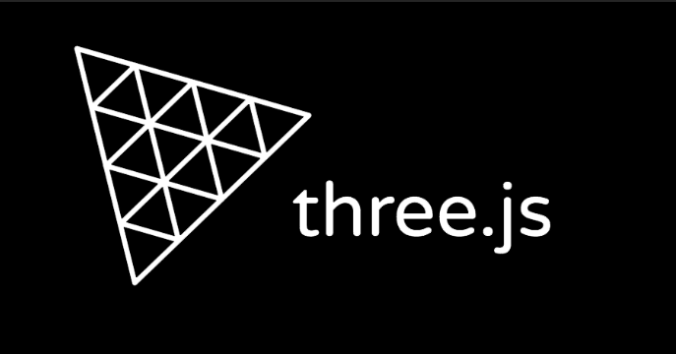
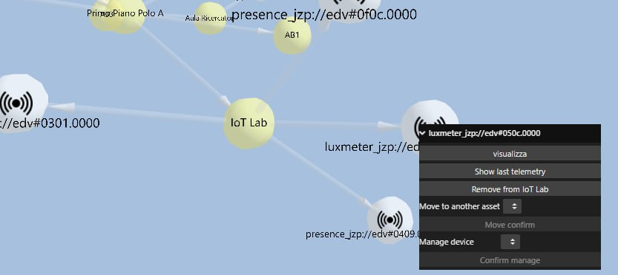
THREE.JS AND LIL-GUI
Three.js is a cross-browser JavaScript library used to create and display animated 3D computer graphics in a web browser using WebGL. It is the main module on top of which 3D-force-directed-graph was developed.
https://threejs.org/
Additional layer of Threejs (sprite-text), has been added to the project to render convenient texts always facing the user perspective, while moving the graph.
https://www.npmjs.com/package/three-spritetext/v/1.1.0
Dat-GUI was the standard component leveraged by Three.js to render controls for scene objects. Since it is not longer maintained, drop-in replacement lil-gui was utilized to render controls on grap nodes.
https://lil-gui.georgealways.com

Slide 11
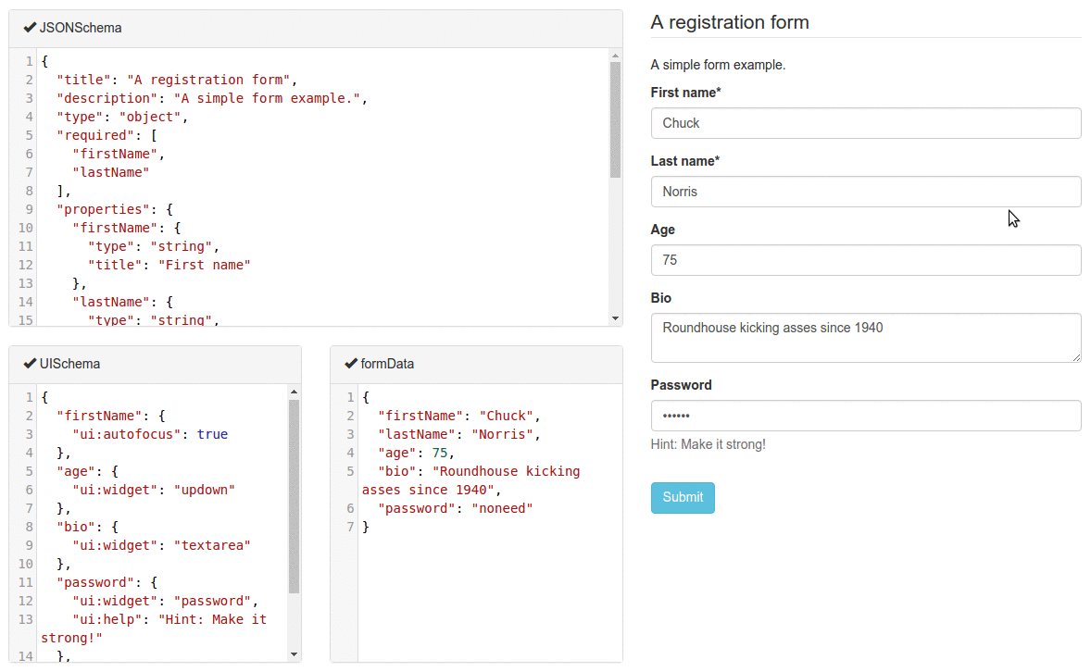
React-schema-form for settings ui
Widget development mini IDE interface provides a section to specify the JSON schema of widget settings for automatically generating a UI form using the react-schema-form builder.
This generated UI form is displayed in the Advanced mode in the Appearance tab of widget settings.
The Settings Object serialized by this schema, is used to store specific widget settings and is accessible from the widget’s JavaScript code.
https://rjsf-team.github.io/react-jsonschema-form/docs/

Slide 12
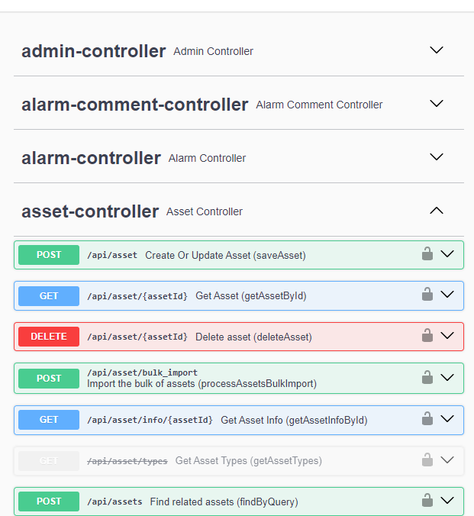
ThingsBoard REST API
An extensive set of APIs is provided to manage every kind of aspect of the platform (administrative tasks, assets and device handling, relationships management, telemetry, and so on).
ThingsBoard REST API interactive documentation is available via Swagger UI. Community Edition demo server API documentation is open to everyone at this link https://demo.thingsboard.io/swagger-ui/index.html
Once you have ThingsBoard server installed, an interactive documentation is always available at URL http://YOUR_HOST:PORT/swagger-ui.html
Convenient Angular service components are provided by the Thingsboard extension project, wrapping the most useful part of the APIs

Slide 13
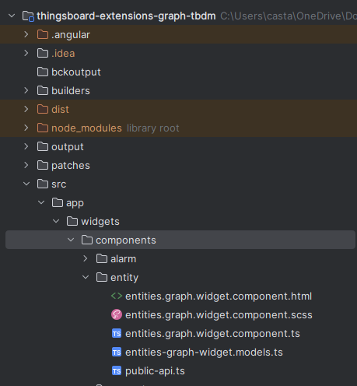
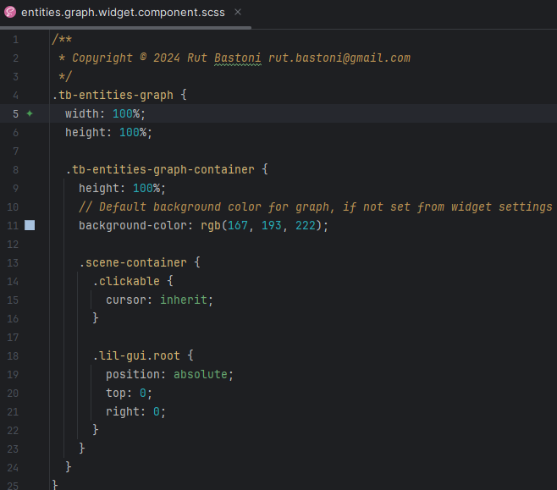
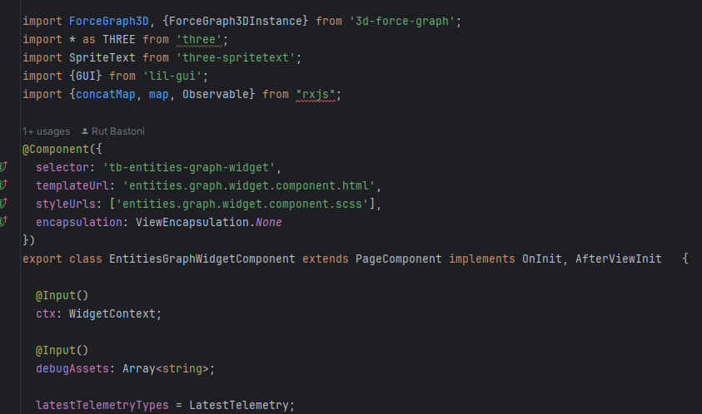
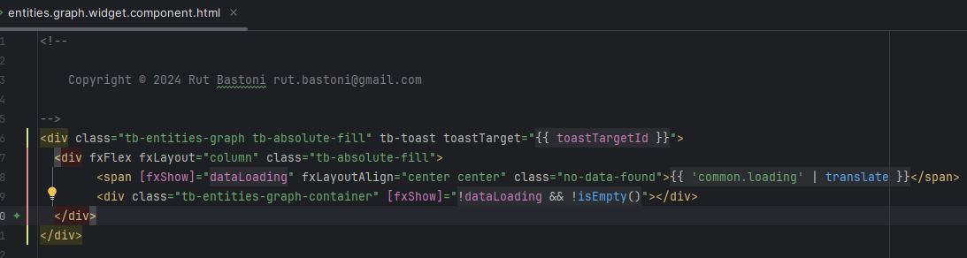
ANGULAR entities graph COMPONENT ANATOMY
Inherited from PageComponent at the same level of other default components of extensions project
https://github.com/rutbastoni-unicam/thingsboard-extensions-graph-tbdm

Slide 14
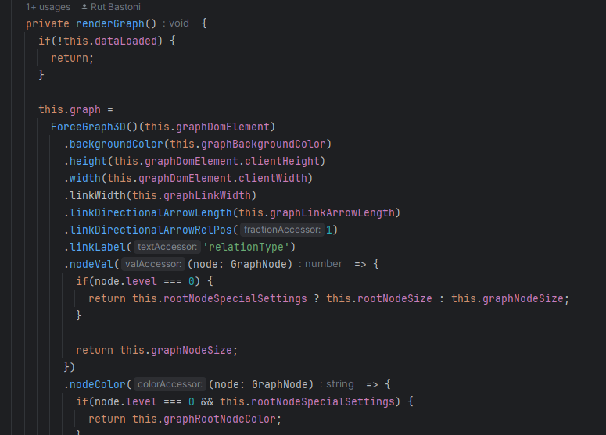
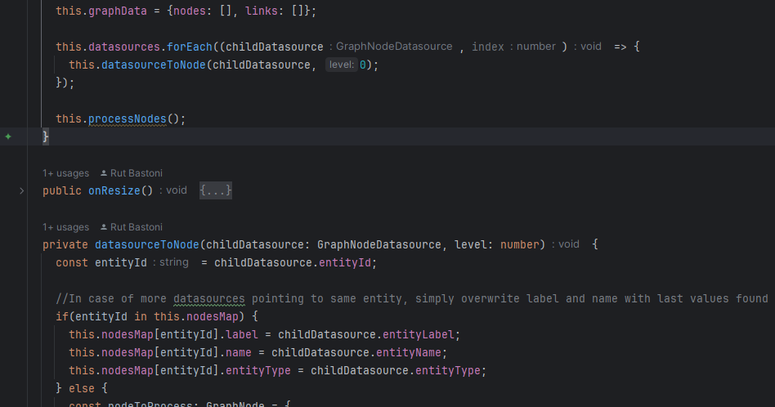
GRAPH-RENDERING ALGORITHM
Entities hierarchy is recursively traversed by means of Datasources Thingsboard APIs
3d-force-graph APIs to render graph and handling events according to widget settings

Slide 15
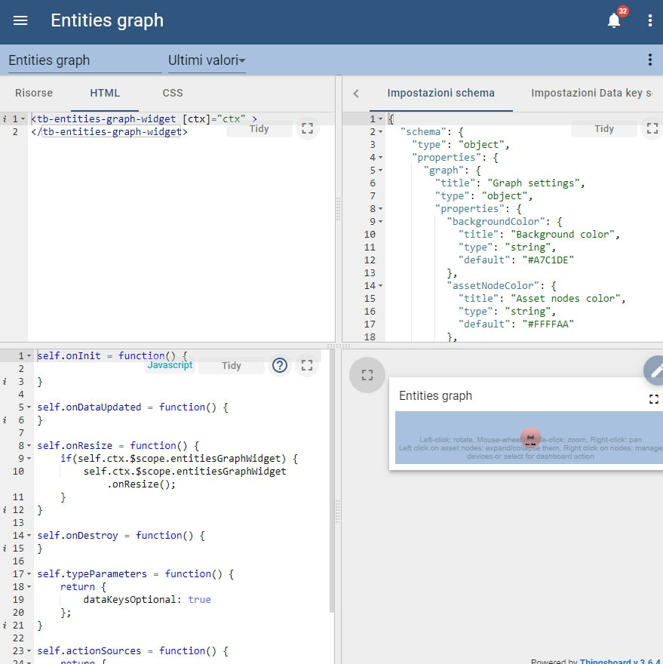
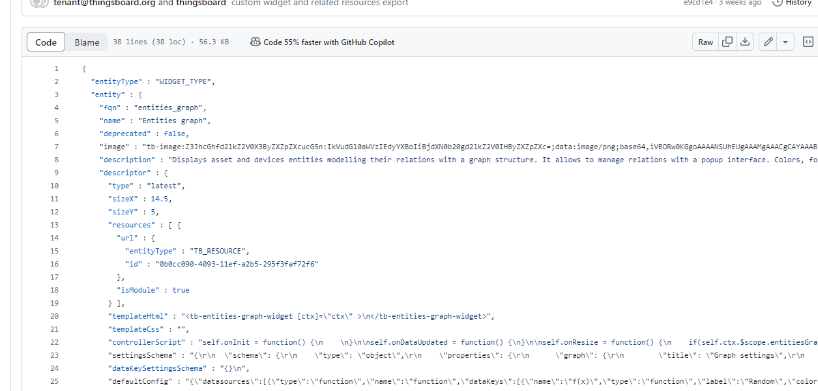
Thingsboard graph widget anatomy
Developed Angular widget referenced in HTML section of mini IDE
Navigation to sub-states of dashboard handled in Javascript section
Final result packed into json entity Thingsboard json format, suitable for import and export to other environments

Slide 16
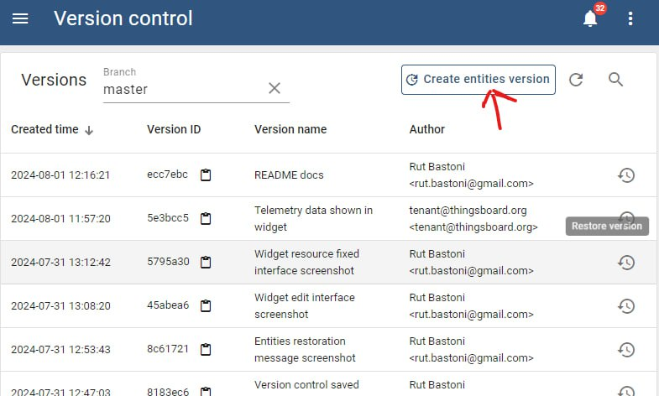

DEMO SETUP
Main repository https://github.com/rutbastoni-unicam/thingsboard-tbdm-graph-project contains docker yml with configured sample Thingsboard environment to run
docker compose up -d
Once the platform is up and running, you can follow instructions at README.md to import all entities structure from repository json backup files into the system

Slide 17
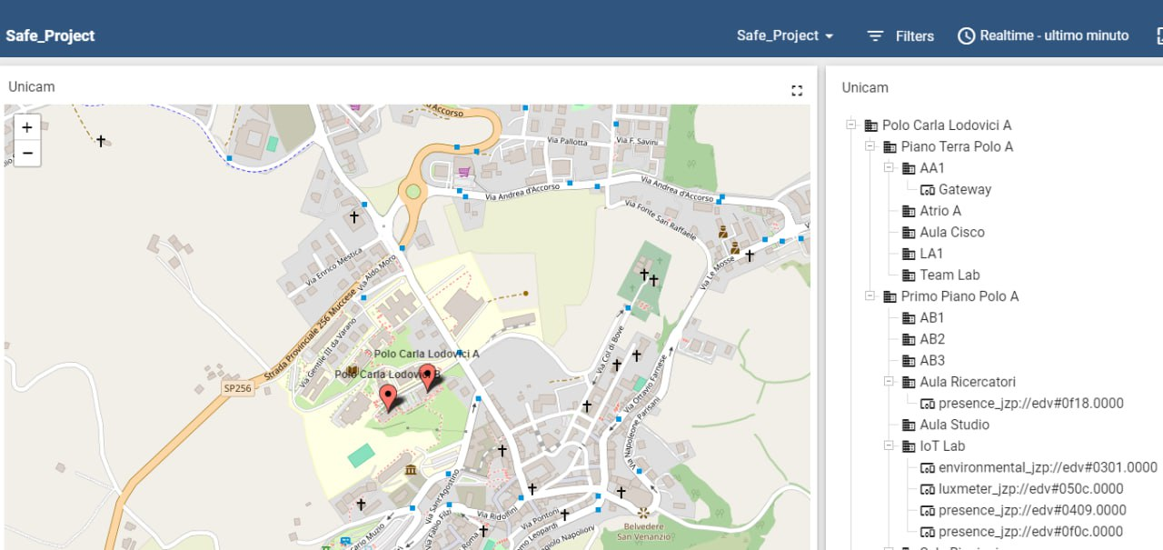
SAMPLE ORGANIZATION assets and devices hierarchy
COMPUTER SCIENCE FACULTY
–
UNIVERSITY OF CAMERINO
Original dashboard rendered with default entities hierarchy widget
Difficult to scroll when a lot of assets and devices are involved
No way to add relationships management without triggering actions to change dashboard view (navigation to sub-state)

Slide 18
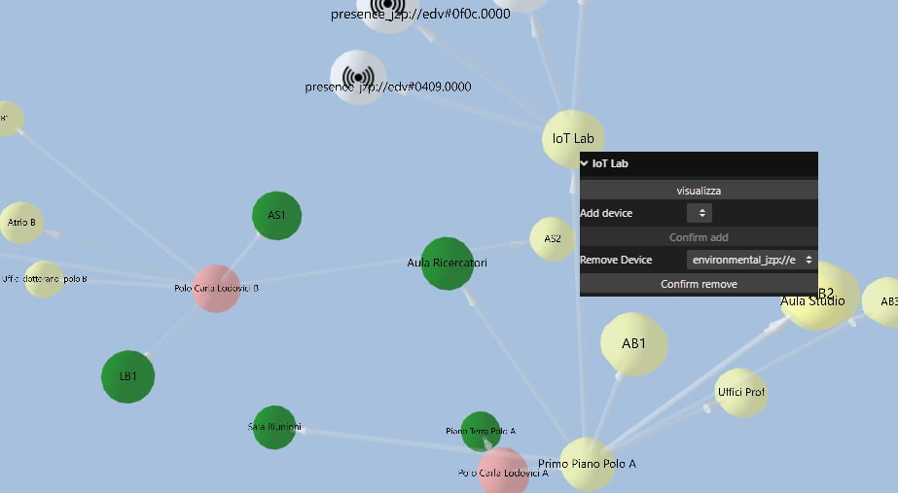
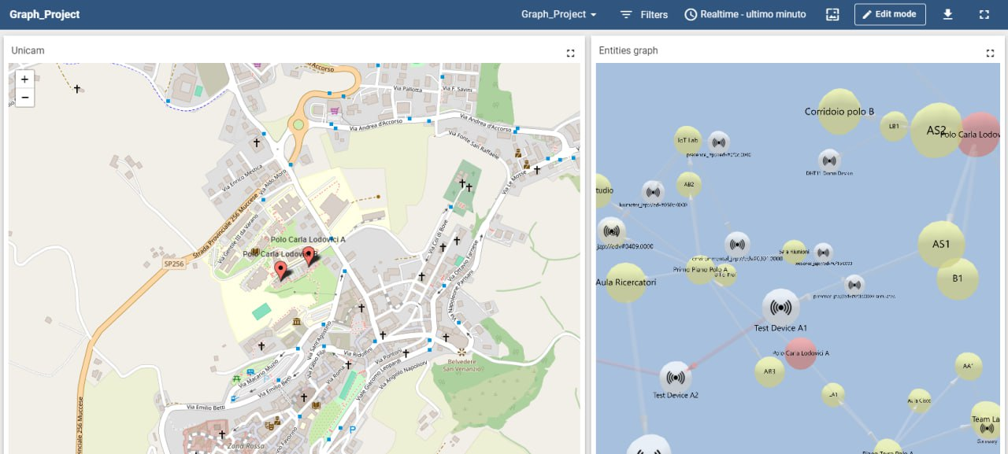
dashboard with graph widget
Easy to view fullscreen, zoom, move and rotate, thanks also to always-user-facing text sprites
Implements features to collapse nodes if needed, and to render management controls on top of nodes

Slide 19
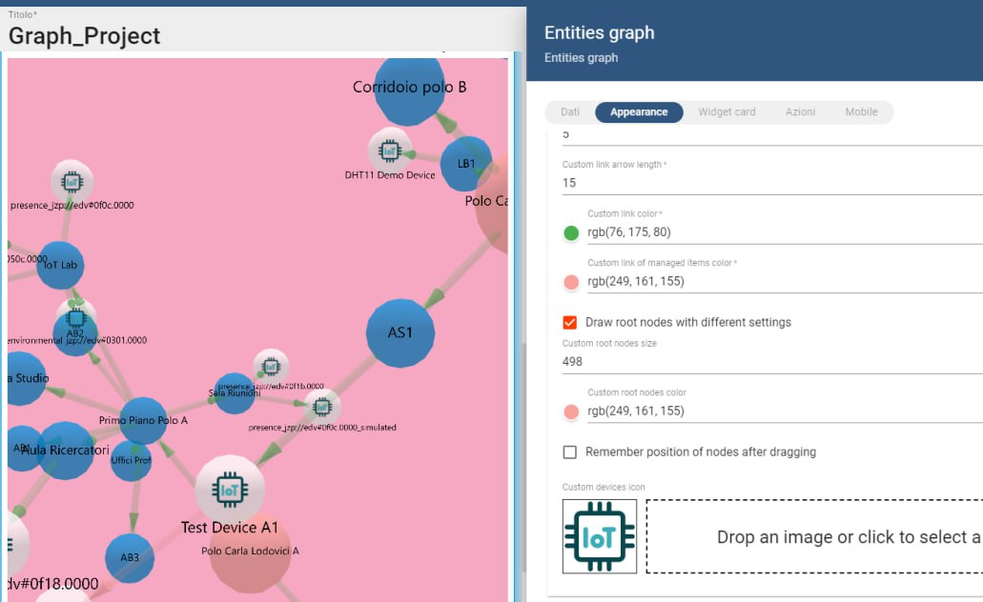
Applying custom graphical settings
A wide set of graphical settings form has been implemented to let the dashboard customize the appearance of the graph as widget
Rendering aspect can be configured by changing colors, background, size of arcs and nodes, and even IOT devices icon

Slide 20
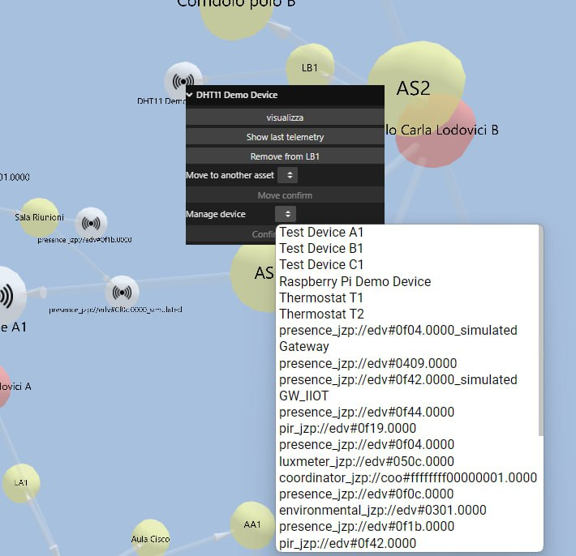
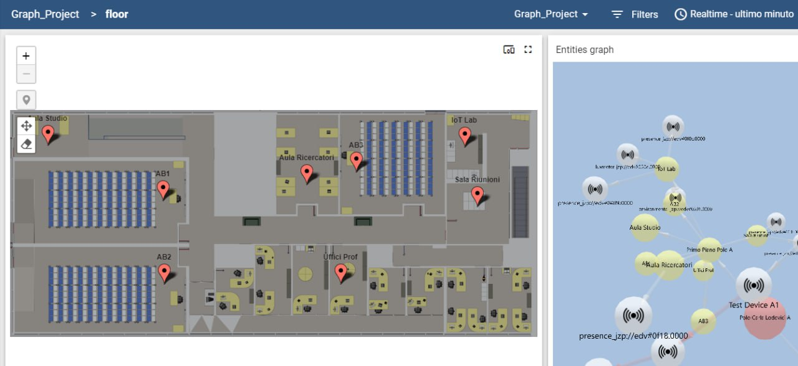
DEVICES MANAGEMENT AND NAVIGATION TO STATES
Lil-gui controls are rendered with right click on top of asset and device nodes
REST APIs are internally called and utilized to get list of all available devices, and to set or remove relations among entities
‘Contains’ relation models relationship among an asset and devices in it, ‘Manages’ relation is possible from one device to others
Can control every aspect of relations: add/remove device from asset, move device to another asset, manage/unmanage device from a controlling other device
If configured in widget settings, button for navigation action to another dashboard sub-state (like the original ‘Safe’ dashboard) is rendered in controls

Slide 21
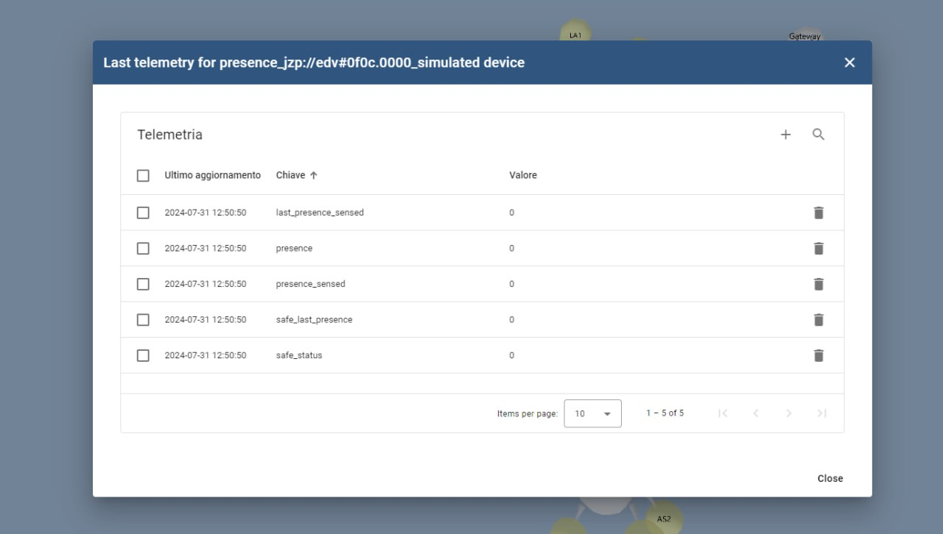
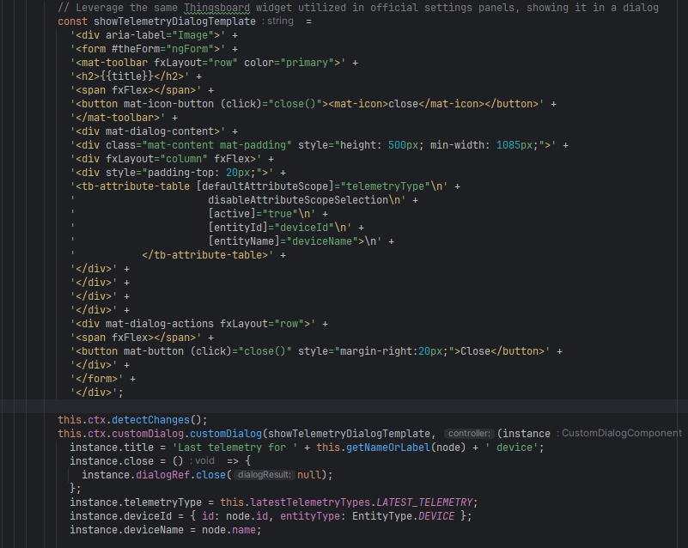
DISPLAYING DEVICE TELEMETRY
Device nodes controls render a button allowing to open a dialog with last device telemetry
Thanks to the Thingsboard extensions structure, this result is achieved reusing the standard platform AttributeTableComponent
AttributeTableComponent encapsulates all the logic needed to call APIs to get last telemetry, and to beautifully displaying it in a system-style table, requiring only to pass selected device attributes from the parent graph component

Slide 22

FUTURE IMPROVEMENTS
Debug and fix some behaviors of graph forces when a node is dragged, fixed, and others pull away
Better settings form, switching from auto-generated ones to latest Thingsboard platform Angular components, and extending them to cover all aspects of the graph
Autocomplete search-field rendered on top of graph layout, like the standard Entities Hierarchy widget
Improve the style of rendered controls
Fork and extend 3d-force-graph to handle customized control messages (instead of workaround implemented in project)
Internationalization of texts
Filter functions in settings, to let customize selected entities from datasource, telemetry keys to display, etc.

Slide 23
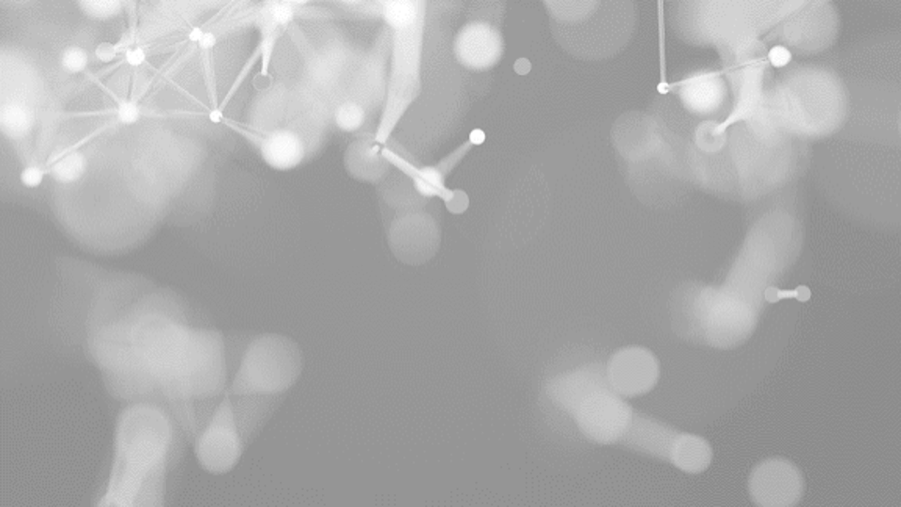
THANK YOU
STUDENT
Rut bastoni
Prof.
Massimo Callisto De Donato

